Slide 1

Cardiac Disease Analysis Report
This report analyzes cardiac disease patterns and characteristics, based on demographics, blood pressure, cholesterol levels, and other key indicators. The goal is to identify risk factors and trends to inform preventive health strategies.
by Divya Prakash

Slide 2
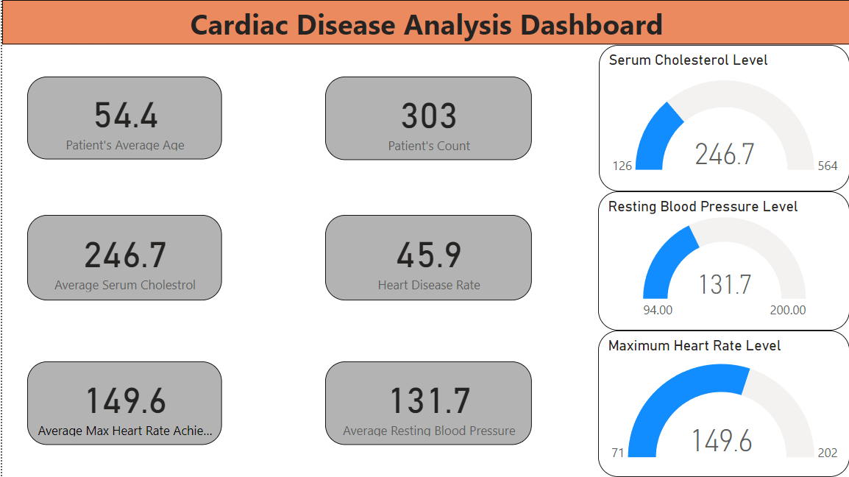
Demographics Overview
1
Average Age of Patients
54.4 years
2
Patient Count
303
3
Average Resting Blood Pressure
131.7 mmHg
4
Average Serum Cholesterol
246.7 mg/dL
Heart Disease Rate: 45.9%

Slide 3
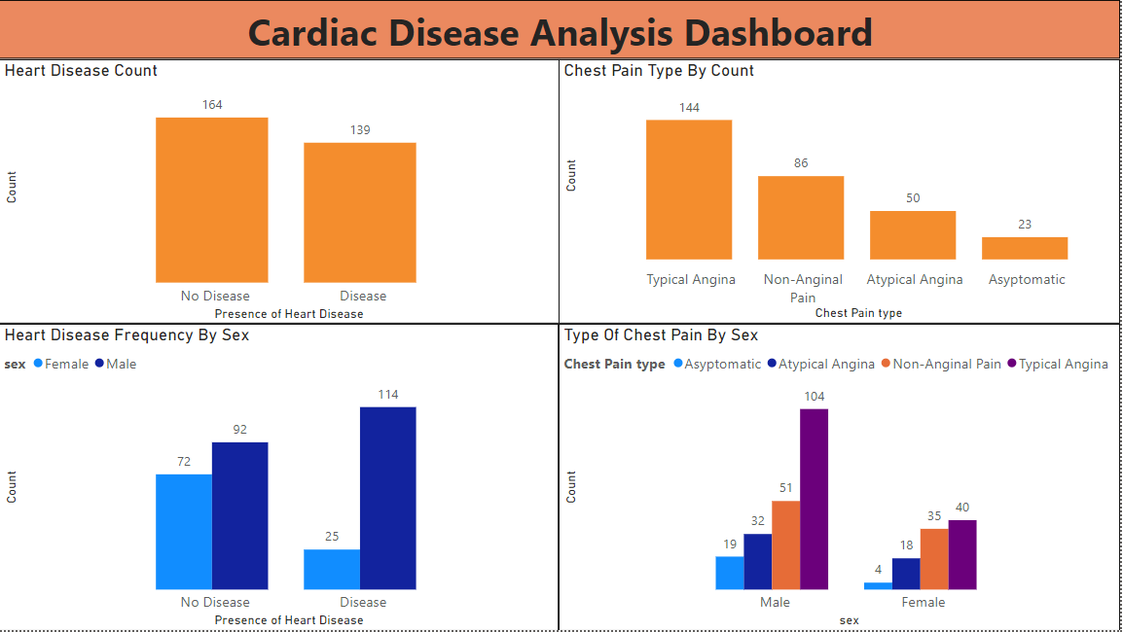
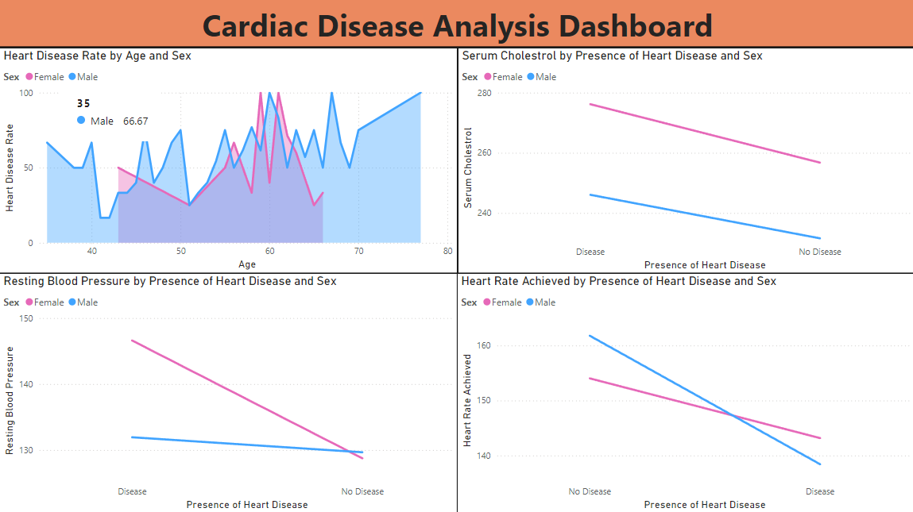
Heart Disease Distribution
Patients with Heart Disease
Patients without Heart Disease
139
164

Slide 4
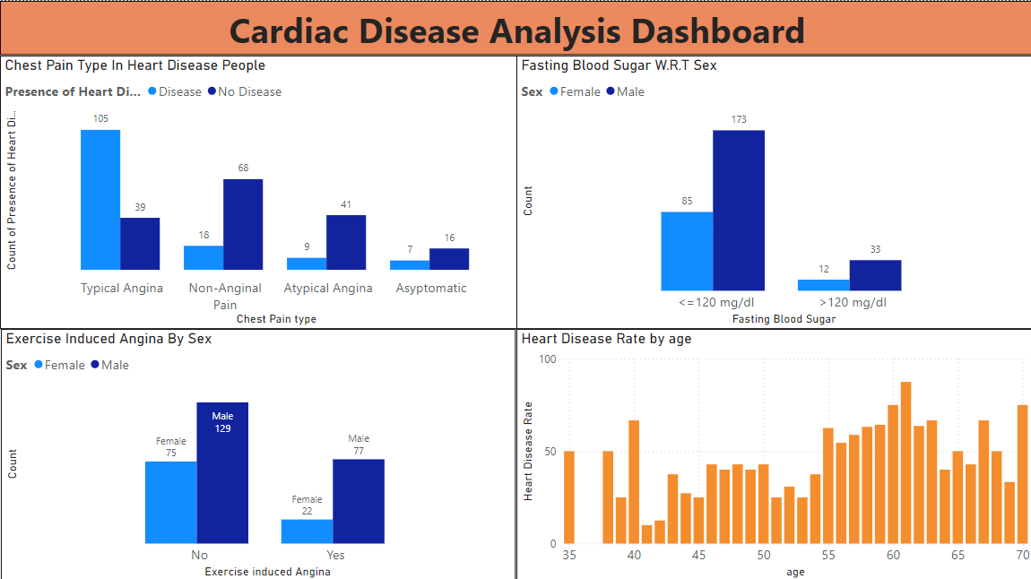
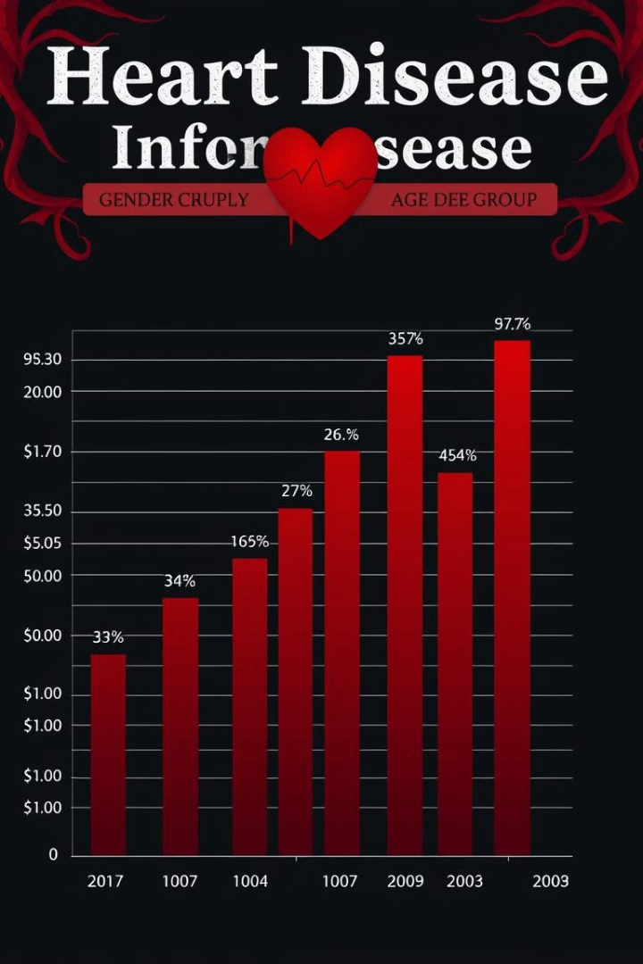
Heart Disease by Gender and Age
1
Gender Distribution
Higher incidence among males (114)
Compared to females (25).
2
Age Distribution
Heart Disease Rate by Age:
Higher in older age groups
Especially those between 60-70 years.

Slide 5
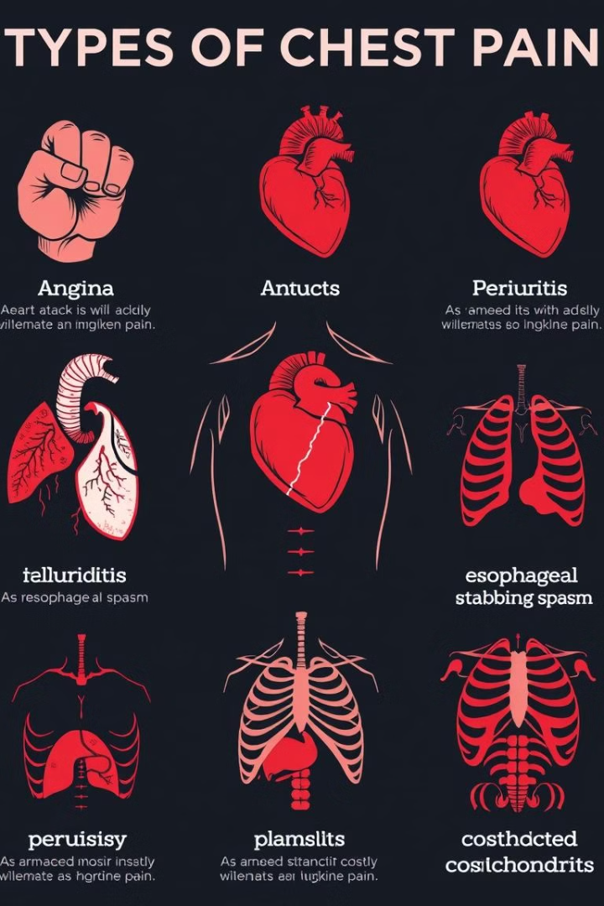
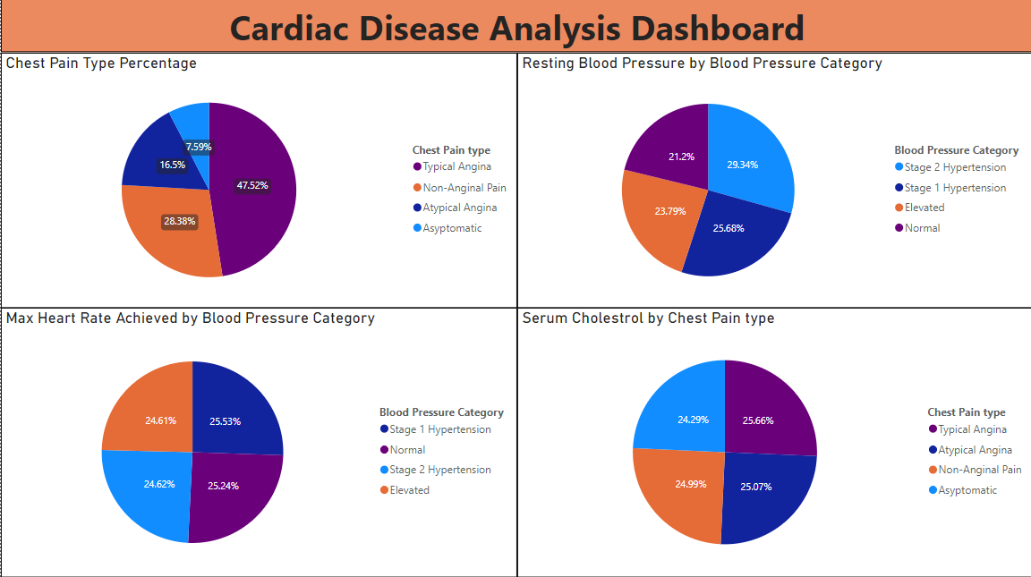
Chest Pain Types
Distribution
Typical Angina (47.52%),
Non-Anginal Pain (28.38%),
Atypical Angina (16.5%),
Asymptomatic (7.59%).
Gender Variability
Higher incidence of chest pain types in males.

Slide 6
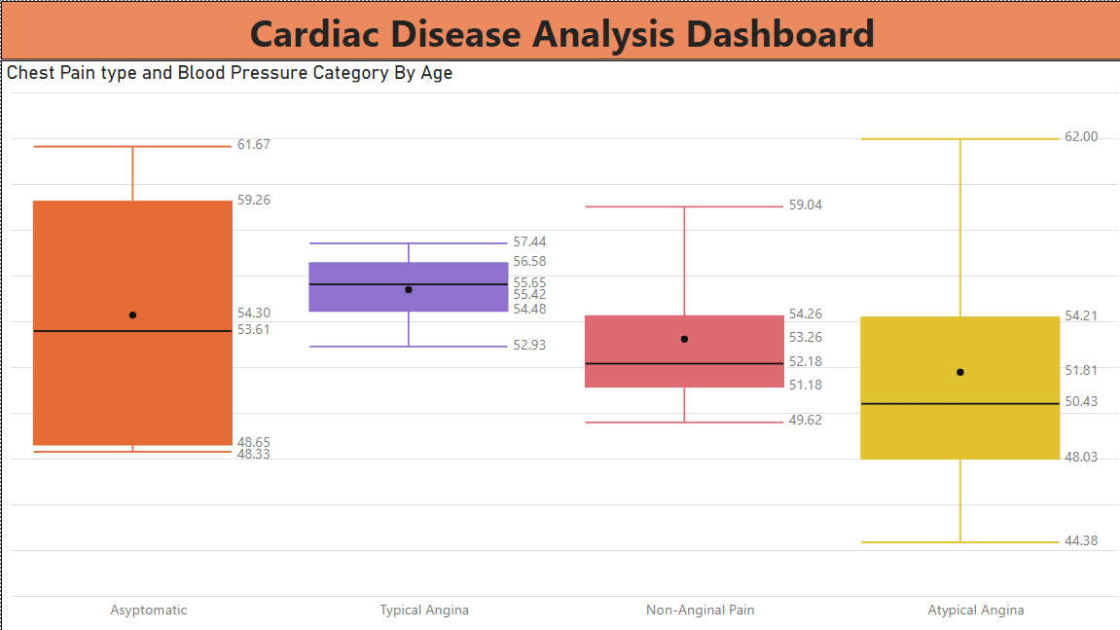
Exercise-Induced Angina and Additional Indicators
1
Exercise-Induced Angina
2
Thallium Stress Test Results
3
Multiple Vessel Disease
Greater prevalence in males, suggesting higher susceptibility to cardiac stress from exercise.
Males more commonly show reversible defects.
283 cases, predominantly in males.

Slide 7
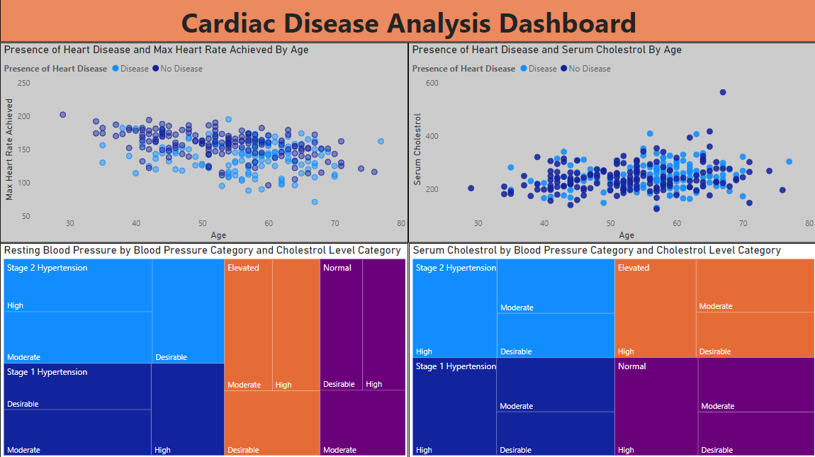
Blood Pressure and Cholesterol Levels
Blood Pressure Category
Percentage
Stage 2 Hypertension
29.34%
Stage 1 Hypertension
25.68%
Elevated
23.79%
Normal
21.2%
Cholesterol Levels: Elevated cholesterol, especially among those with hypertension, highlights the need for targeted management.

Slide 8

Conclusions and Recommendations
1
Conclusions
This analysis emphasizes significant factors contributing to cardiac disease, such as age, cholesterol, and hypertension, with a higher risk noted among older males. The findings highlight potential areas for targeted interventions to manage risk in high-incidence groups.
2
Screening
Routine screenings for high-risk demographics, especially males over 50.
3
Lifestyle Adjustments
Recommendations to manage cholesterol and blood pressure through diet and exercise.
4
Monitoring Physical Activity
Especially for patients with angina to prevent exercise-induced cardiac events.

